Slide 1

Python Training
Thrivent Financial - October 2018

Slide 2

Warm and Friendly Welcome words from Kevin Courtney
A happy Kevin Courtney at work

Slide 3
Agenda
Infrastructure and Tools
Data Engineering + Data Science
Data Types and Structures
Input/Output Operations
Data QA and Cleaning
Data Visualization
Machine Learning
Statistics and Stochastics
Object Oriented Programming
Wednesday
Thursday
Friday

Slide 4
Training Objectives
Increase overall Python programming capabilities across the Thrivent analytics team
Identify areas of focus for analytics and model conversion as they relate to data science at Thrivent
Increase familiarity with development tools in Python and how they connect to the new Data Science platform

Slide 5
Python Essentials
Infrastructure & Tools
Thrivent Financial - October 2018

Slide 6
Agenda
Python versions
Libraries
Anaconda
Jupyter
IDEs
Spyder
PyCharm

Slide 7
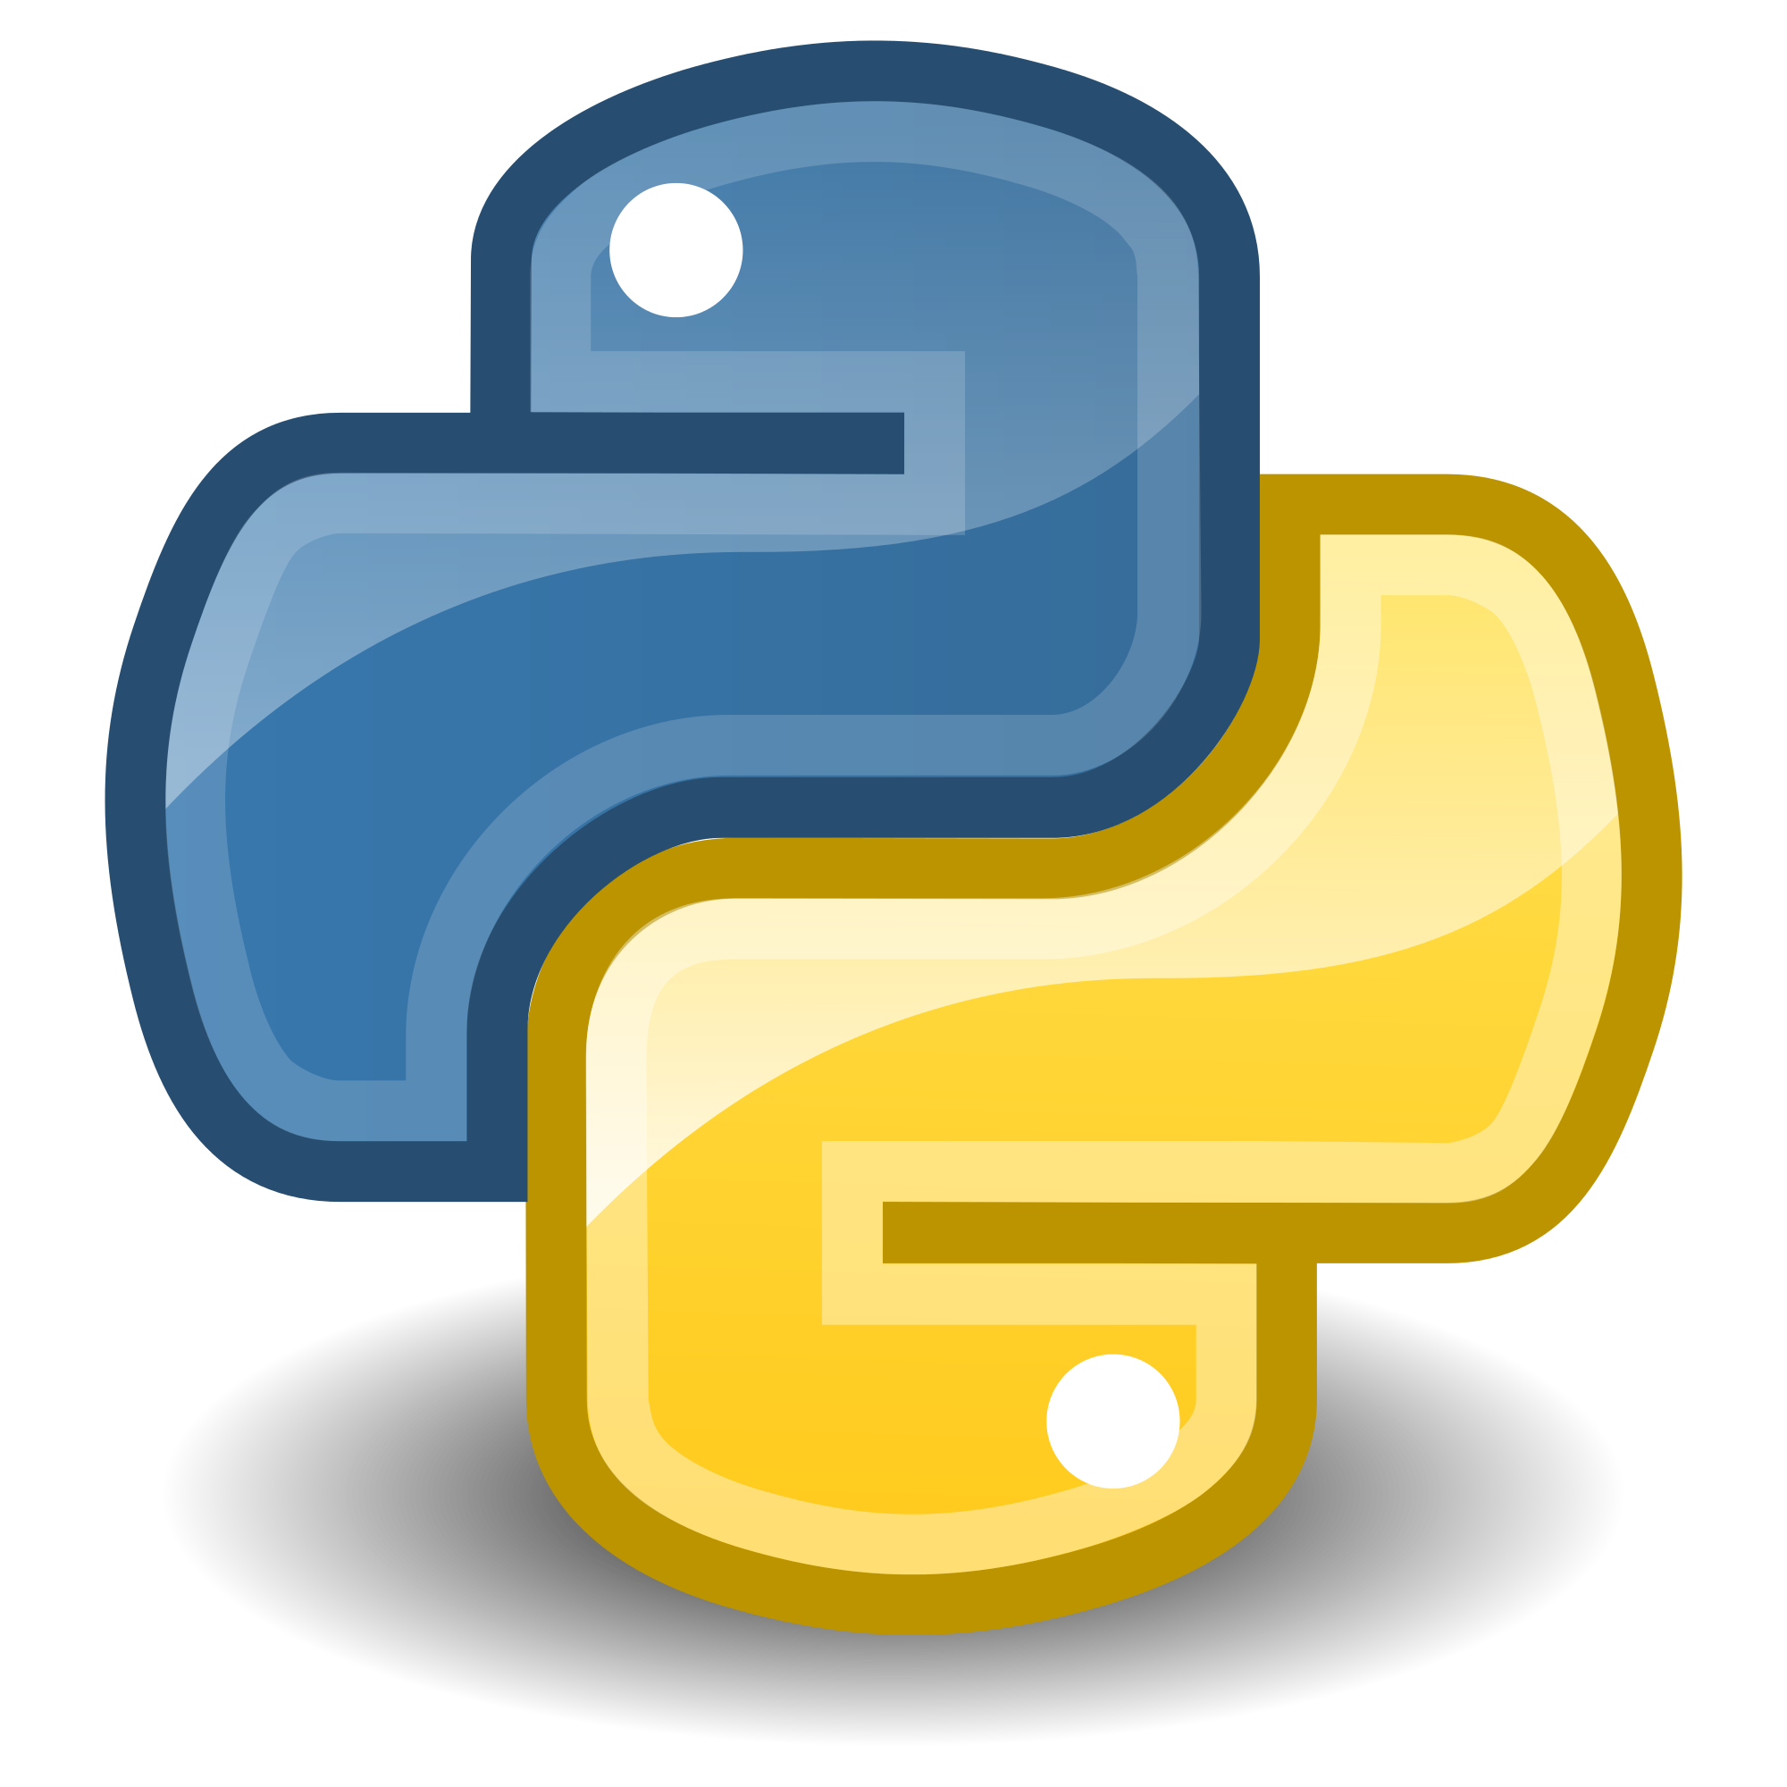
Python

Slide 8
Python Versions
What version of Python should we use?
Python 3.X
Python 3.7 was released in June 2018
Python 3 was first released in 2008
Most libraries are now written for and support Python 3
Some small differences in syntax and data types
Python 2.7
The last version of Python 2.7 was released in mid 2010
Official end-of-life date 2020
Some libraries still do not support Python 3
Follow this link to the Python Software Foundation for a good explanation of the main differences between Python 2 and Python 3

Slide 9
PEP: Python Enhancement Proposals
Since Python is an open-source project, there is a large community of developers who contribute with suggestions for changes to the language. These are called “PEP’s”.
The link in the title has a list of all completed PEPs and PEPs open for consideration.
An example of a PEP:
PEP484: Data Type Hints: allows the developer to annotate the data types for function inputs, making the functions easier to use by other developers.

Slide 10

Libraries
Like most open-source programming languages, there are many libraries written and supported for Python.
Be careful with library version numbers for compatibility when sharing code and working in teams.
You can use `pip freeze` to get a list of all libraries loaded and their version numbers
Use Python environments to work with projects that have references to different library versions
The Anaconda Distribution automatically installs the most commonly used data science packages:
567 packages, according to the Anaconda website
215 packages, according to my own `pip freeze` results

Slide 11
Installing Libraries
While many libraries are installed with the Anaconda distribution, you may need to install new ones or update existing libraries.
Libraries can be installed/updated using `pip` or `conda`
pip install
Searches for packages in https://pypi.org/pypi
Identifies dependencies and installs those
conda install Same as above - seems to have a lower success rate
From PyCharm Some IDEs make it possible to see installed packages and install new ones directly from the IDE - like PyCharm

Slide 12
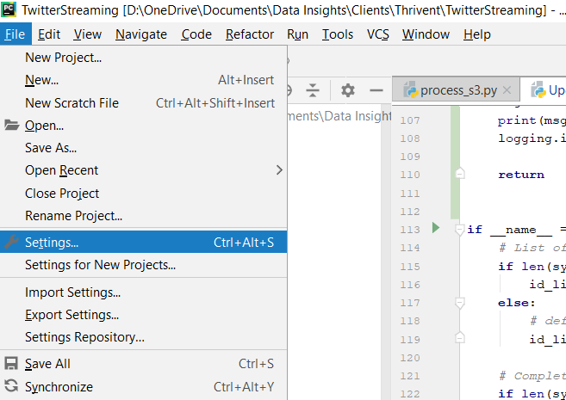
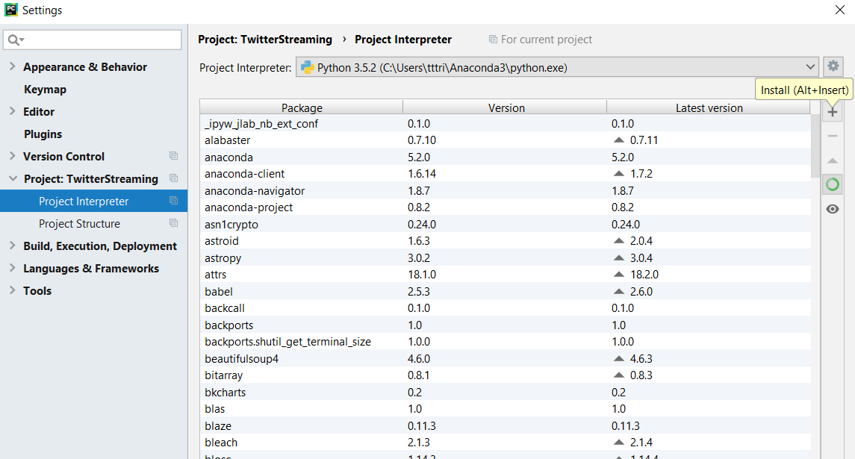
Installed/Installing Packages - PyCharm

Slide 13


Slide 14
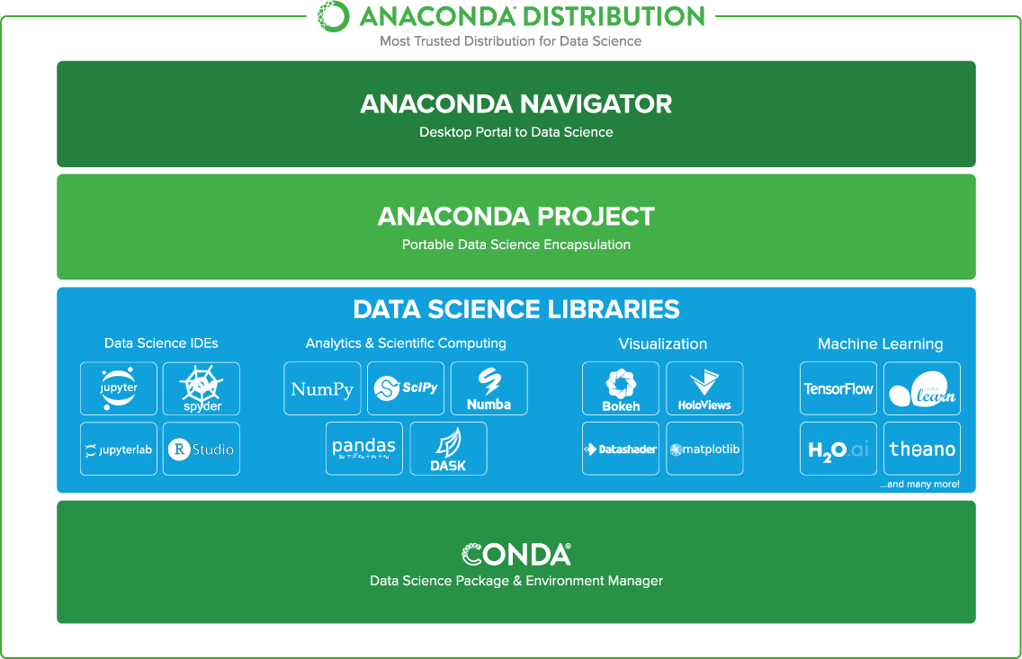
Anaconda

Slide 15


Slide 16
Jupyter
Formerly known as IPython
Julia + Python + R = Jupyter
Jupyter Notebook: good for data exploration, iteration, in-line documentation
Jupyter Lab: next-generation Jupyter Notebook. Improved user interface, basically.

Slide 17


Integrated Development Environments (IDE)
Used for application development
Integrates with many different potential components:
Source control
Data resources
Unit-testing
Build-environments
File management - organizes python files into directories, libraries, and projects
Examples:
PyCharm - by JetBrains
Spyder - part of the Anaconda distribution

Slide 18

Contact Info
John Chandler Tom Trinter Ben Wood john@datainsightsllc.com tom@datainsightsllc.com ben@datainsightsllc.com

